Slide 1
Building a new Employee Security System
Overview:
This framework collects the raw data from sensors and observers the human movement
How data was recorded?
Each person performed six activities (WALKING, WALKING_UPSTAIRS, WALKING_DOWNSTAIRS, SITTING, STANDING, LAYING) wearing a smartphone (Samsung Galaxy S II) on the waist. Using its embedded accelerometer and gyroscope
About Dataset?
The sensors operate at a 50 Hz sampling rate. The time series signal is extensively preprocessed, aggregating sensor data over 2.58-second windows. In addition to raw sensor data—where the accelerometer measures forces along three axes, and the gyroscope captures rotation rates around three axes—the dataset enriches these time series signals with over 500 engineered features. These additional features are designed to enhance model building.

Slide 2
What type of ML problem it is?
Human activity recognition is time series classification task .it involves predicting movement of person based on census data and traditionally involves methods to correctly engineer features from the raw data in order to fit machine learning models we can say it as multi-class classificstion problem
Steps:
Importing The Modules
Reading The Data
Analysis
Preparing Train And Test Data
Machine learning models

Slide 3
About data:
First, we conduct a t-SNE analysis to determine if these different activities are separable. t-Distributed Stochastic Neighbor Embedding (t-SNE) is a dimension reduction method that calculates the similarity between data points and reproduces them in a low-dimensional space with maximized separation
--Static activities such as standing, sitting, and laying are clearly separable from dynamic activities.
--Among static activities, laying is distinct from sitting and standing, likely because the accelerometer can detect significant changes in the direction of gravity.
--However, sitting and standing often get confused, posing a challenge for later classification analysis.
--Walking activities, in general, are separable, but some intermixed clusters are present.

Slide 4
How Are The Labels Distributed?
Although there are fluctuations in the label counts, the labels are quite equally distributed.
Static and dynamic activites are different.as expected from real world when participants are moving the data is normally distributed with long line

Slide 5
If tAccMean is <-0.8 : Standing or Sitting or Laying.
If tAccMean is > -0.6 Walking or Walking Downstairs or WalkingUpstairs.
If tAccMean > 0.0 WalkingDownstairs.
If angleX.gravityMean > 0 then Activity is Laying.
We can classify all datapoints belonging to Laying with just a if else statement.

Slide 6
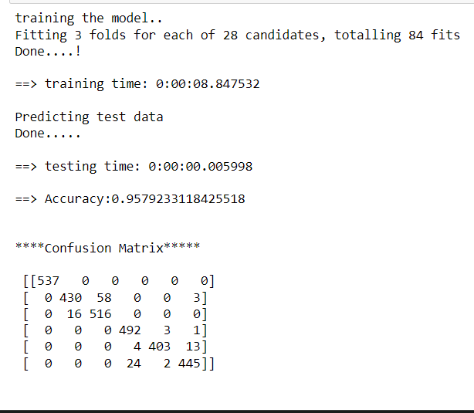
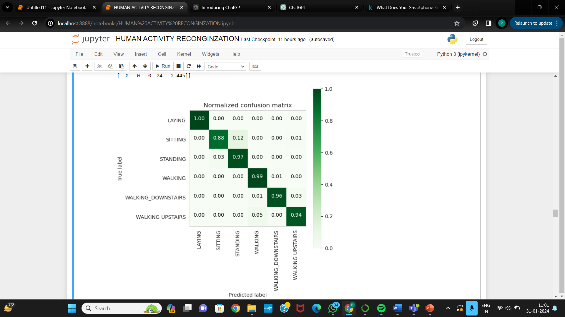
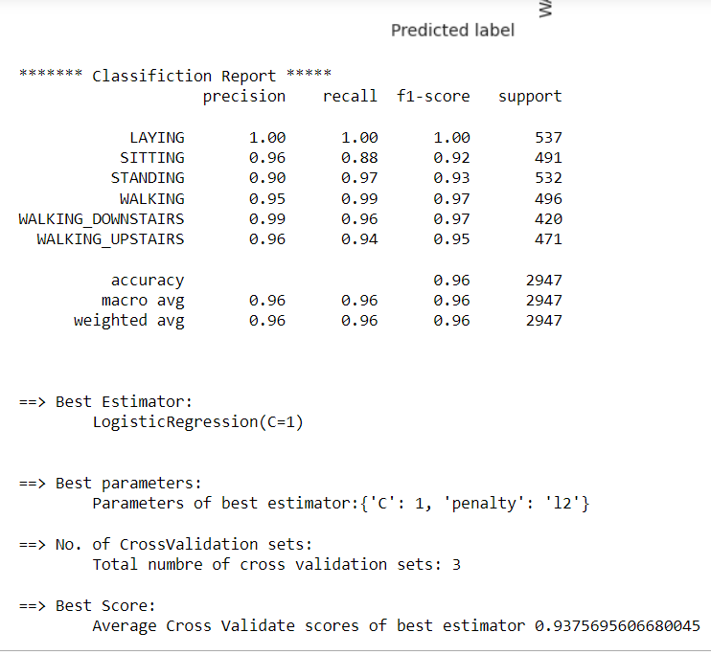
Applying machine learning models:
Results Logistic regression:

Slide 7
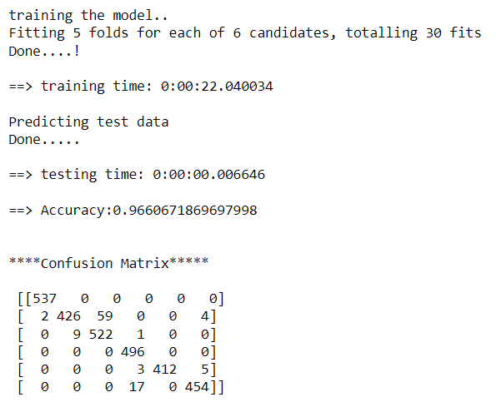
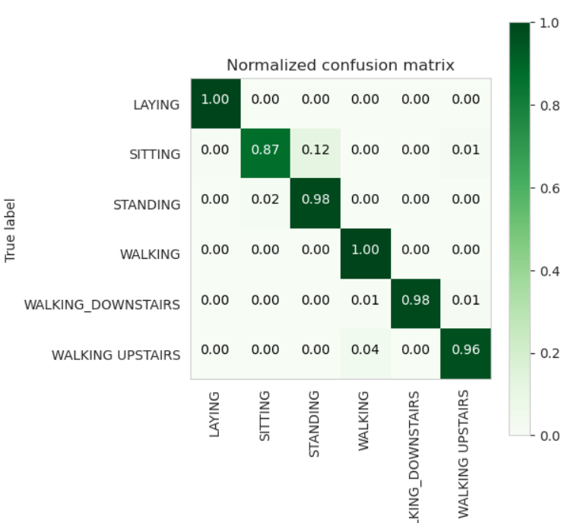
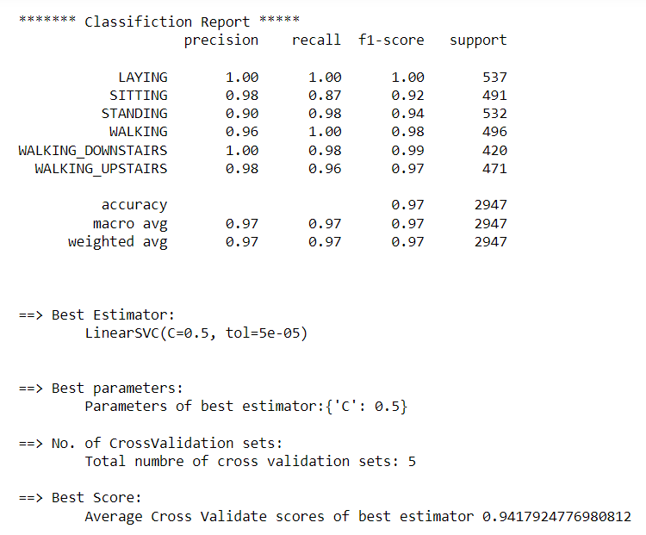
Results Linear SVC:

Slide 8
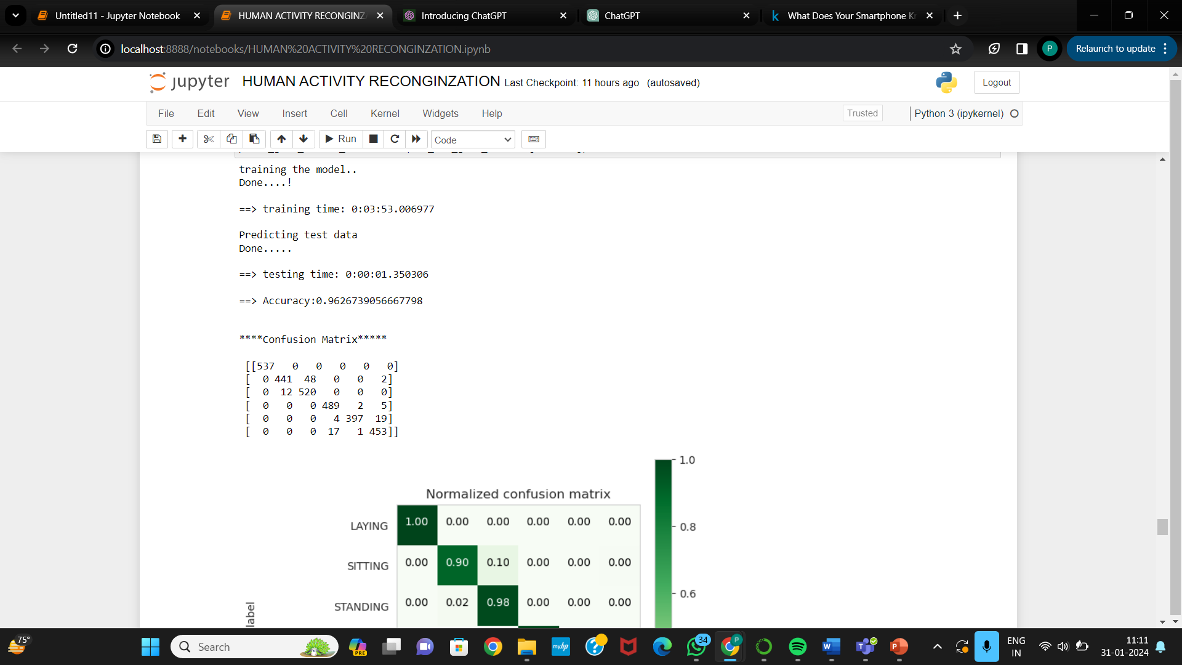
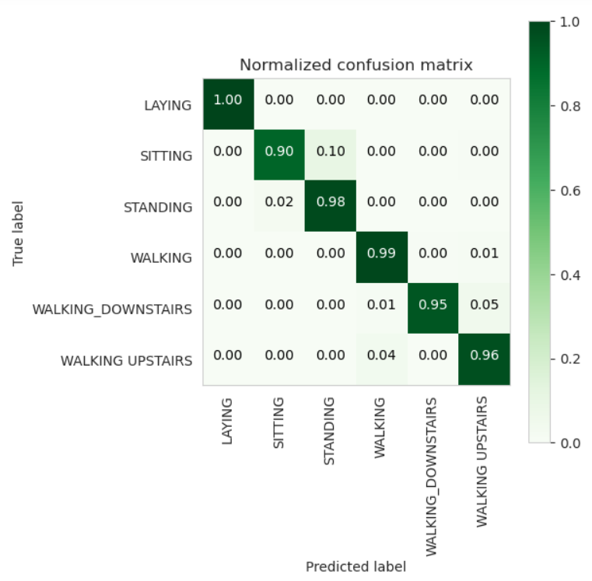
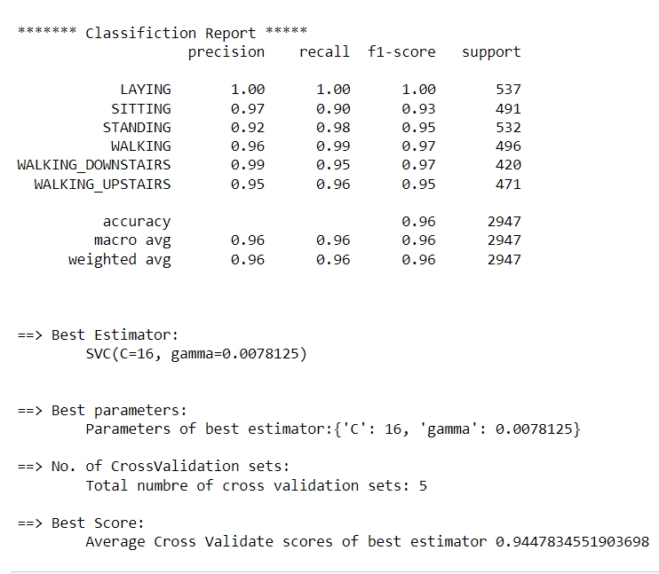
Results KERNAL SVM:

Slide 9
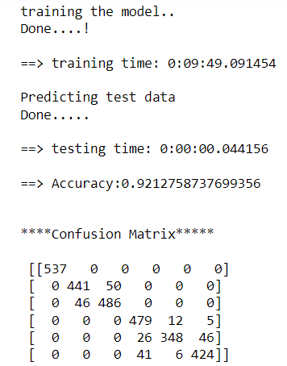
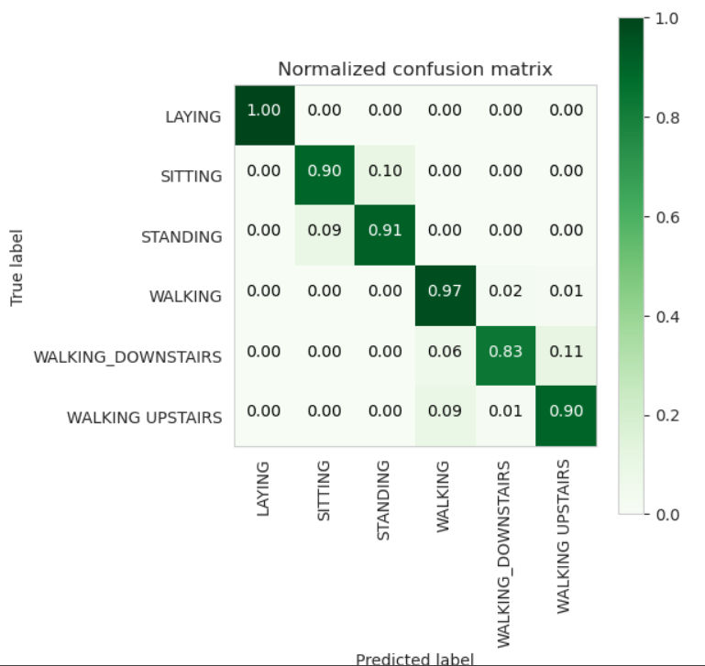
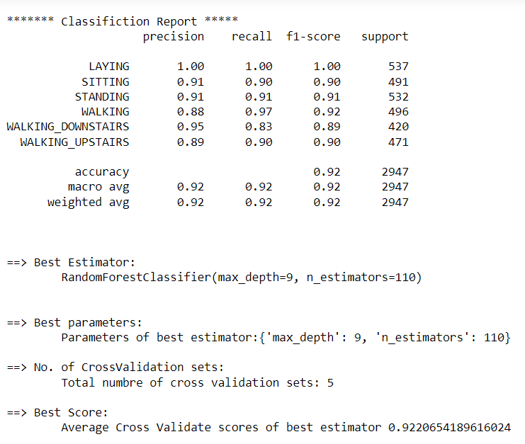
Results RandomForestClassifier :

Slide 11
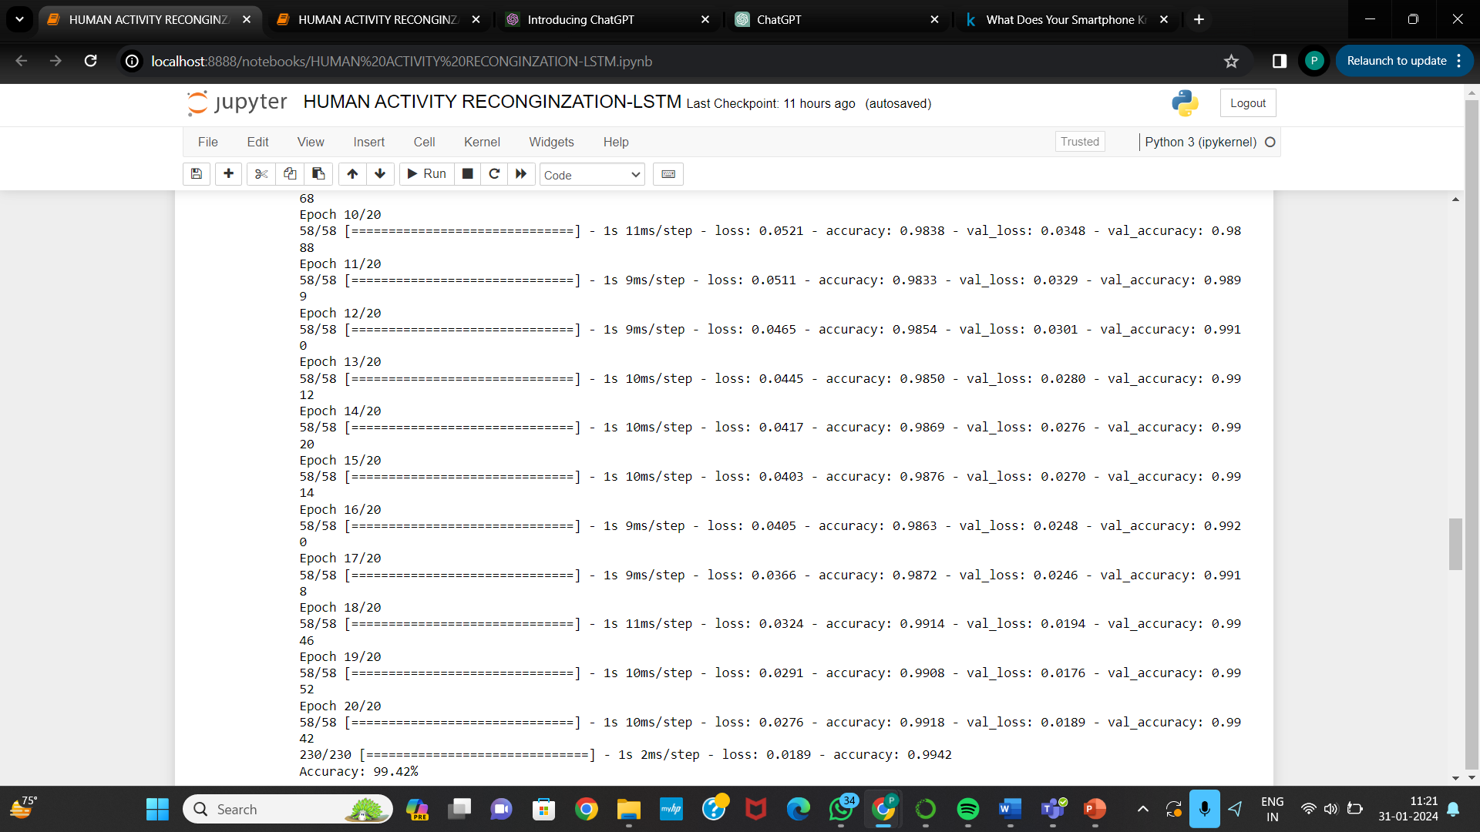
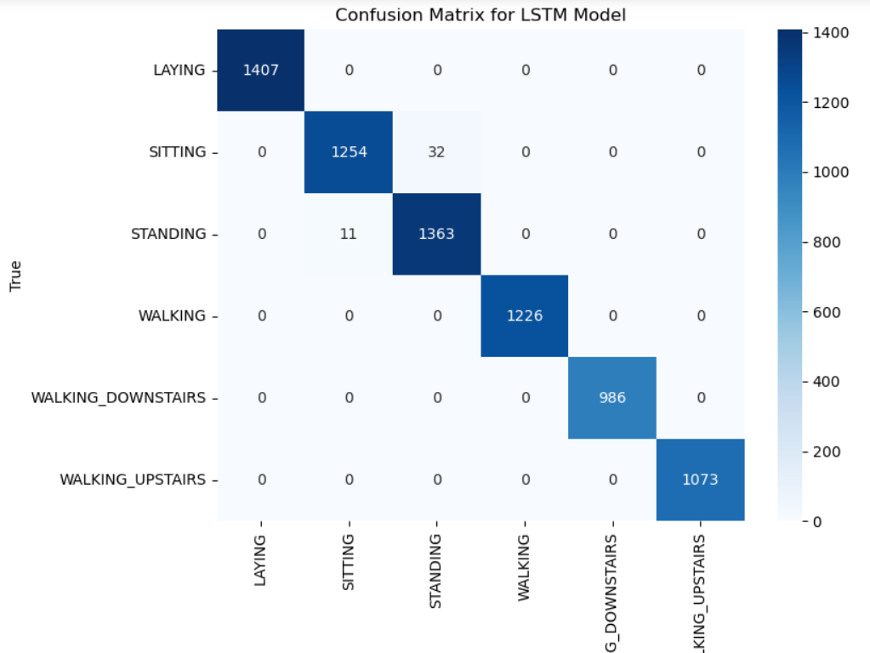
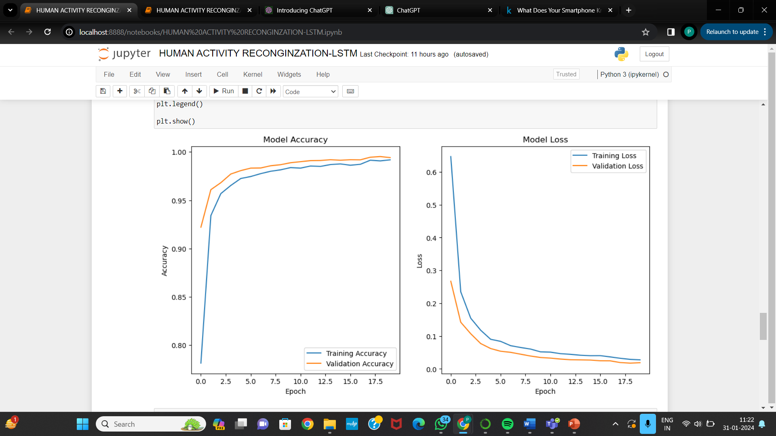
Result LSTM:

Slide 12
CONCLUSION:
Logistic REGRESSION:95.79%
LINEAR SVC:96.61%
RBF SVM:96.27%
RANDOM FOREST:92.13%
LSTM:98%
From this dataset, containing over 500 sensor features from both accelerometers and gyroscopes, our EDA indicated that activities are generally separable, particularly between static and walking activities
Following the EDA, we experimented with models including random forest, RBF SVM,LINEAR SVC and and the LSTM model. Of these, the LSTM model demonstrated the best performance, though with the highest complexity and lacking in interpretability. In contrast, the random forest model. To understand the sources of error, we examine the confusion matrix. It reveals a high misclassification rate between sitting and standing, and among different walking activities (walking, walking downstairs, and upstairs). These misclassifications align with our t-SNE analysis findings, where these activity clusters were heavily mixed
References:
A. Bayat, M. Pomplun and D. Tran, “A Study on Human Activity Recognition Using Accelerometer Data from Smartphones,” Procedia Computer Science, vol. 34, pp. 450 – 457, 2014 F. Attal et al., “Physical Human Activity Recognition using Wearable Sensors,” Sensors 15(12), pp.31314-31338, 2015 C. Ronao and S. Cho, “Human activity recognition with smartphone sensors using deep learning neural networks,” Expert Systems With Applications 59(2016), pp. 235-244. S. Kozina, H. Gjoreski, M. Gams and M. Lustrek, “Efficient activity recognition and fall detection using accelerometers” in Evaluating AAL Systems Through Competitive Benchmarking, Springer, 2013, pp.13-23

